Slide 1
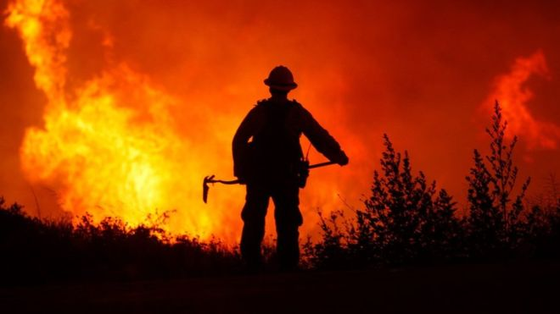
Are Wildfires on the Rise?
Group HSSM: Sania Ahmad, Haris Nawzadi, Mina Yirga, Sayed Zewari

Slide 2
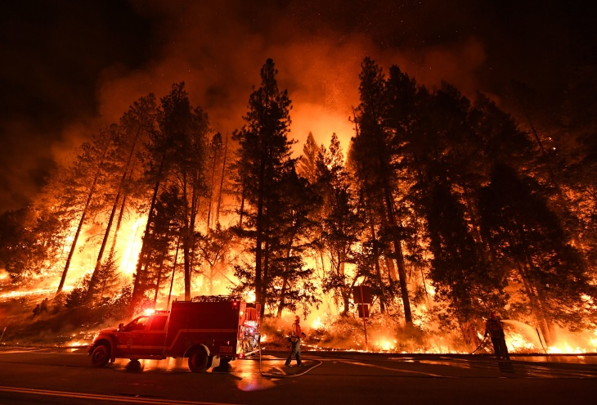
Why Wildfires?
“Scientific evidence for warming of the climate system is unequivocal.” -Intergovernmental Panel on Climate Change
Scientists point to the current trend of increasing global temperatures as evidence for rapid climate change.
They cite a number of additional environmental phenomenon, including warming oceans, glacial retreat, rising sea levels, and extreme weather as evidence of this rapid change.
We set to find out if aforementioned environmental phenomenon have an affect on the number of wildfires.
We analyzed wildfire data gathered in the last three decades to confirm/reject our hypothesis.

Slide 3
Important Questions
Our Null Hypothesis:
There is a measurable and/or significant increase in the number of wildfires in the United States?
Our Alt. Hypothesis:
There is a correlation between the rising number of fires and the rising temperature trends?
Additional questions we asked:
What are the different causes for wildfires, and are any of them weather/climate related?
What regions of the United States have the most wildfires?

Slide 4
Selecting Data
To answer our research questions, we needed to find wildfire data that included the following criteria:
At least 2 decades worth of data (more if possible).
Differentiates each wildfire incident by state, cause, and size.
Comprehensive data to include nationwide events.
We found our data at Buzzfeed News and accessed it through their GitHub repo.
The data includes seven .csv files detailing every reported wildfire incident in the country from 1992 to 2015
Each .csv file was about 80 Mb’s containing information not relevant to our project.
Sufficient time was spent on cleaning the data and putting it into a single workable data set.

Slide 5
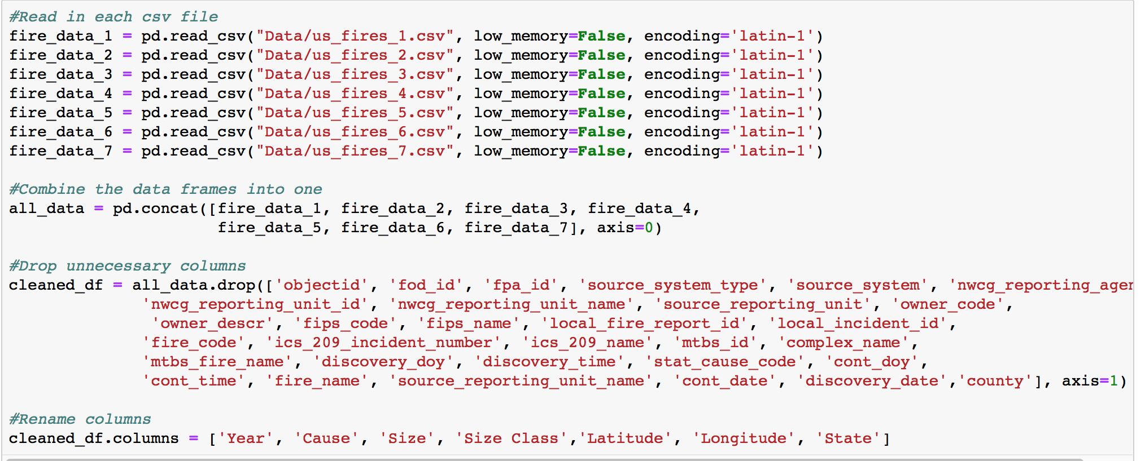
Data Cleanup
1
2
3
4
5

Slide 6
Data Analysis
Initial task was to identify whether there is a measurable rise in wildfires with time.
Further, nationwide combined data was analyzed to portray a graph of fires by state.
Top five states with the largest number of wildfires were identified.
Data for the top five states was further analyzed to demonstrate the primary causes of fire for these states.
Correlation between wildfires and natural/human events were identified.

Slide 7
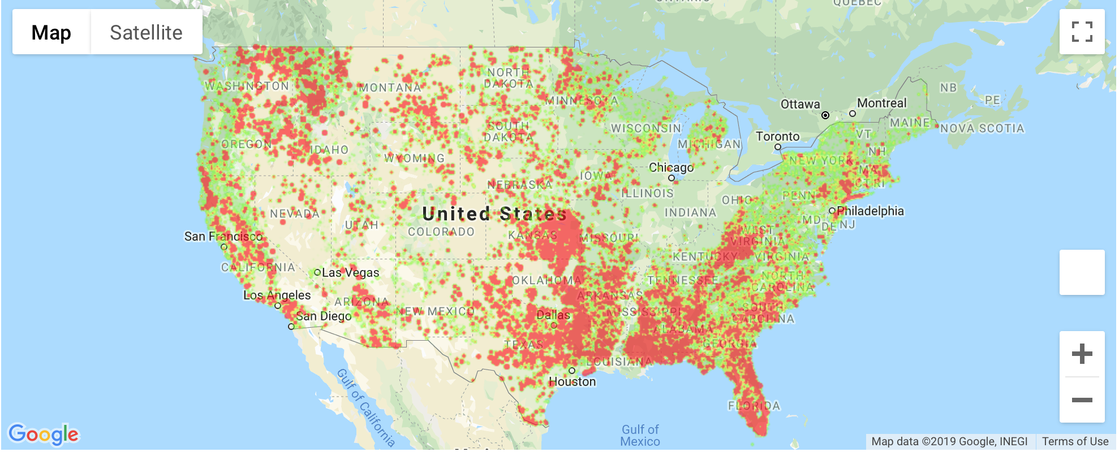
Heat Map of Wildfires
Year 2015

Slide 8
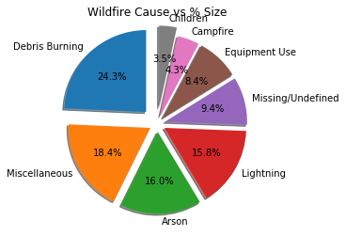
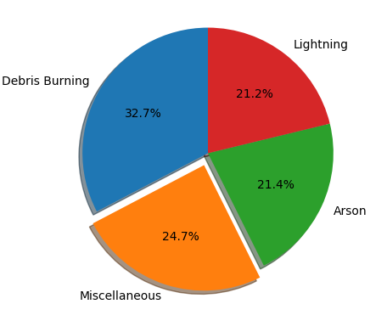
Cause of Wildfires
All Causes
Top Four Causes

Slide 9
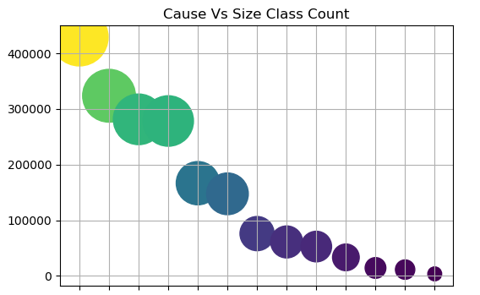
Debris
Misc.
Lightning
Railroad
Fireworks
Arson
Equipment
Children
Smoking
Power Lines
Structures
Undefined
Camp Fire

Slide 12
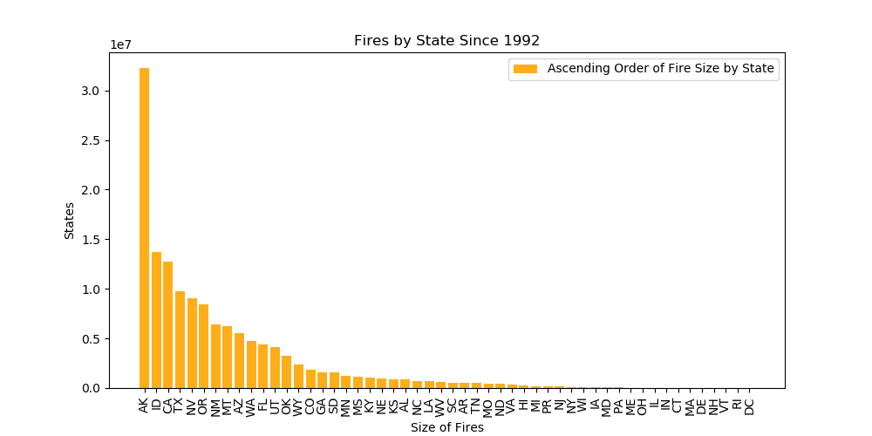
Size in Acres
State
vs. by #

Slide 13
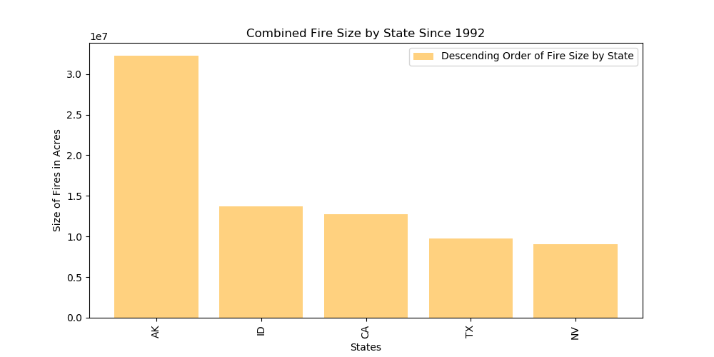
vs. by #

Slide 14
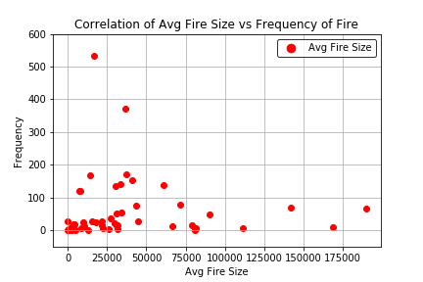

Slide 15
Upward trend
Notes:
Worth looking into why there was a spike in 2006

Slide 16
Temperature trends for the same time period from Climat.gov
Notes:
Worth looking into why there was a spike in 2006

Slide 17
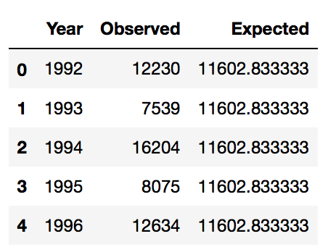
Chi-Squared Test
Critical Value:
33.92443847144381
Chi-square Value:
13284.483445135527
p-Value
0.0
*Not all data shown
Since the chi square value is greater than the critical value (at a confidence level of 95%), we can conclude that there is a statistically significant difference between the observed and the expected values. Additional testing could help us confirm which years specifically

Slide 18
Findings?
There is a measurable increase in the number of wildfires in the US.
We confirm our Null Hypothesis.
There is a likely correlation between the increase in the number of wildfires and the rising temperatures.
We can neither confirm or deny our Alt. Hypothesis.
While California and Georgia lead the way with the total number of fires, Arkansas and Idaho are inflicted with the most damage.
Six out of the 13 causes (~46%) of wildfires are caused by human error and are likely accelerated by favorable weather conditions. A national strategy/policy needs to set in places to minimize these cause.

Slide 19
NO Questions Please Thank You!

Slide 20
Citations:
https://climate.nasa.gov/evidence/
https://climate.org/
https://www.nationalgeographic.com/environment/2018/11/climate-change-california-wildfire/
https://www.ncdc.noaa.gov/sotc/fire/200813
https://developers.google.com/

